Slide 1
MINI PROJECT RESTURTANT

Slide 2
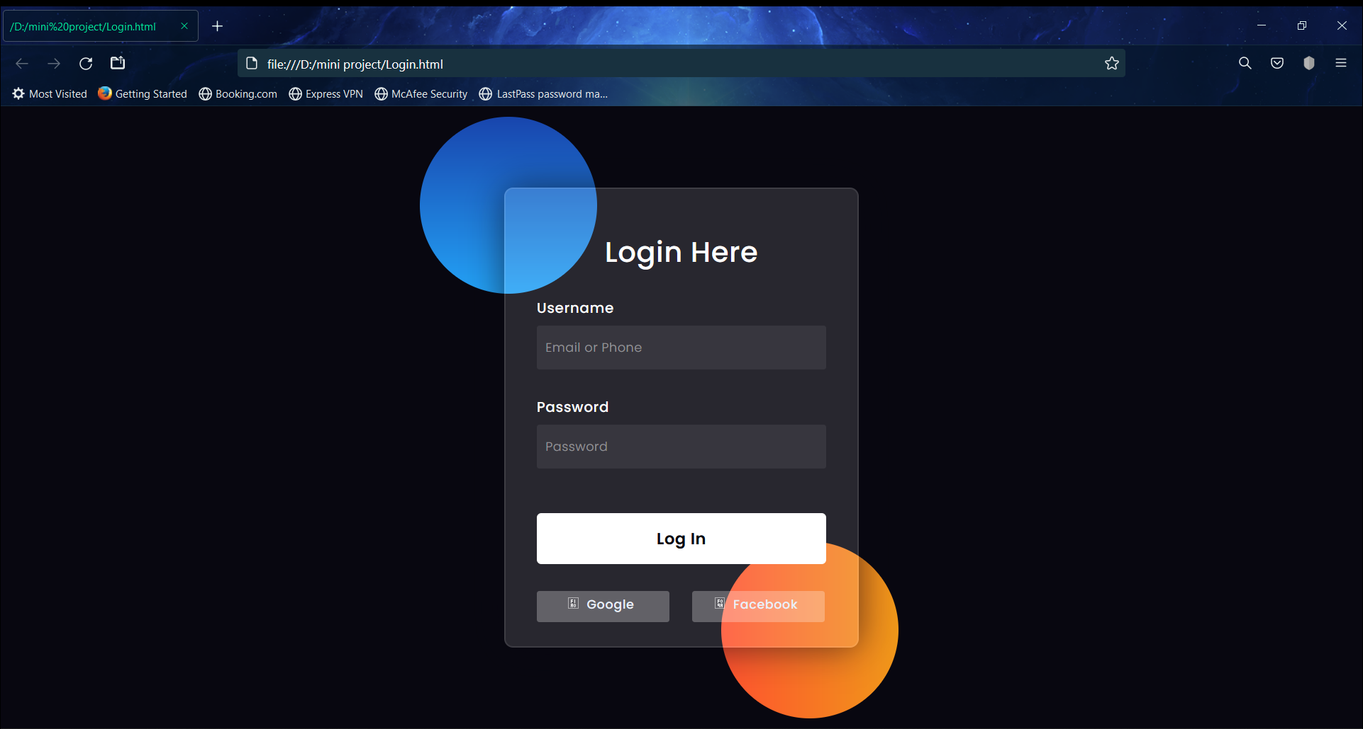

Slide 3
Login page
Login page is a entry page
Login may provide access to entire site or part of website
It contains with Username and Password
It also contains our Google page and Facebook page
Email address –Alphanumeric with ‘@’ (valid Email)
Password Must Contain(10-11)length,1char,1-number
Login button takes you to our page

Slide 4
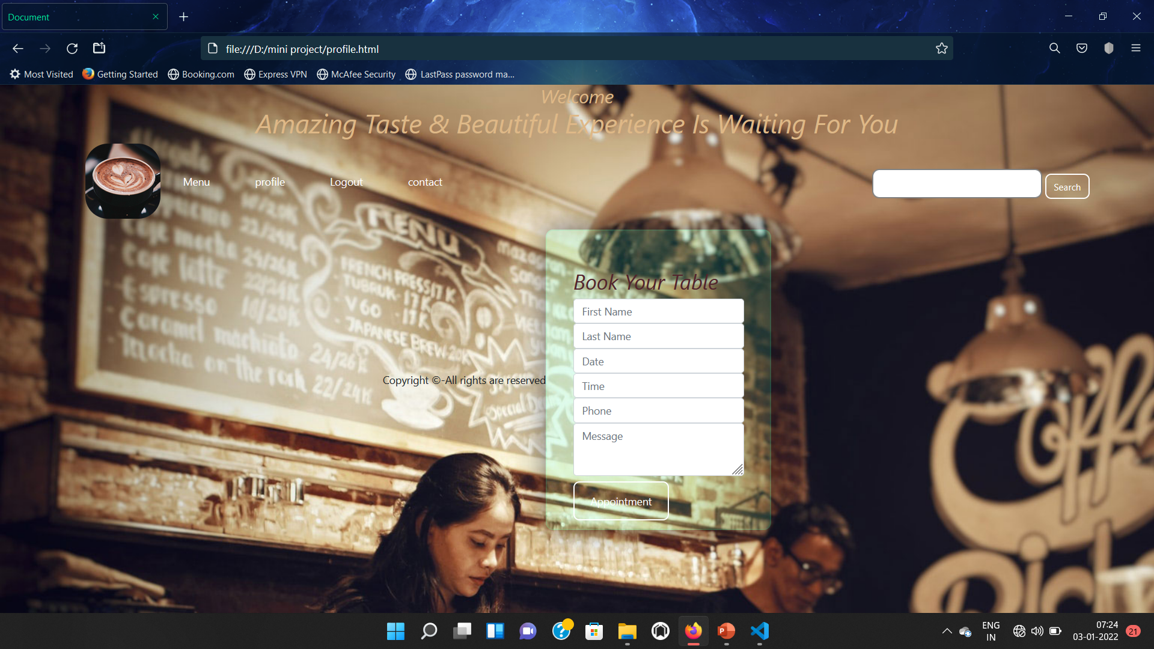

Slide 5
Profile Page
It contains details about or Resturtant
You can book your table
By using Appointment
It contains first name ,last name ,date,time,phone number.
And you can leave your message in the message box

Slide 6
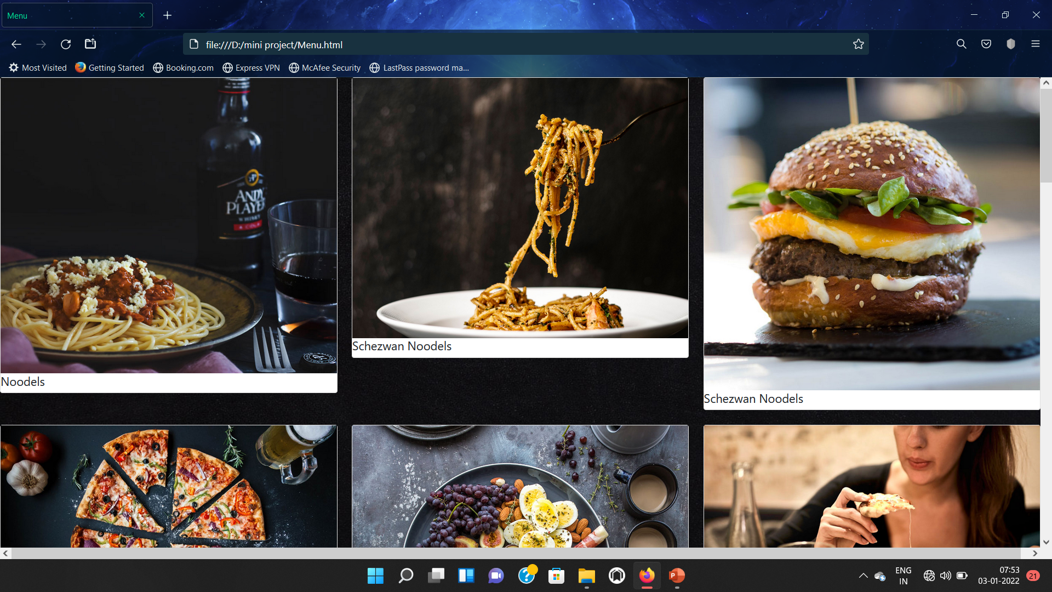

Slide 7
Our Menu
In menu you can see a list of food items
You can select the food
Contact us

Slide 8
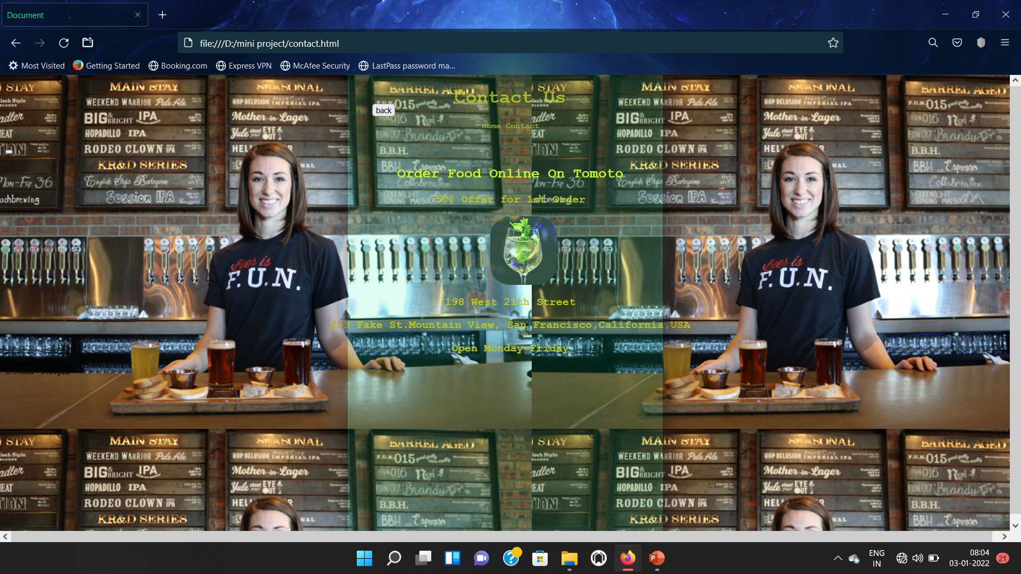

Slide 9
Contact
In contact you can see our online app
App is Tomoto
You can order in the app
We mentioned the location of the resturtant
And the opening time
And working days

Slide 11
Logout
By clicking the logout button
You will appear to the login page
And you can login by clicking login button again when you want to visit

Slide 12
Thank you...

